Slide 1
Artificial Intelligence
Techniques in
Manufacturing

Slide 2
Convolution

Slide 3
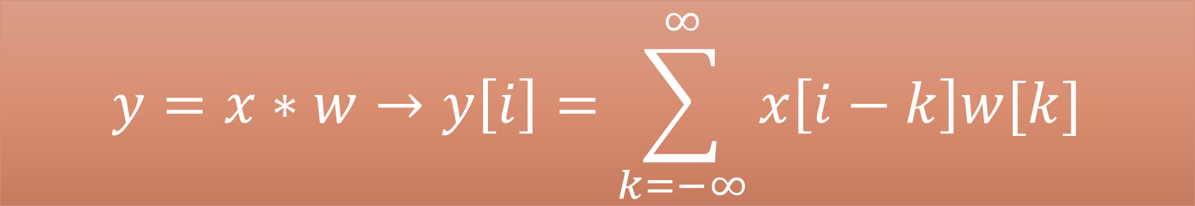
Infinite array
$$y=x∗w→y\left[i\right]=\sum_{k=−∞}^{∞}{x\left[i−k\right]w[k]}$$

Slide 4
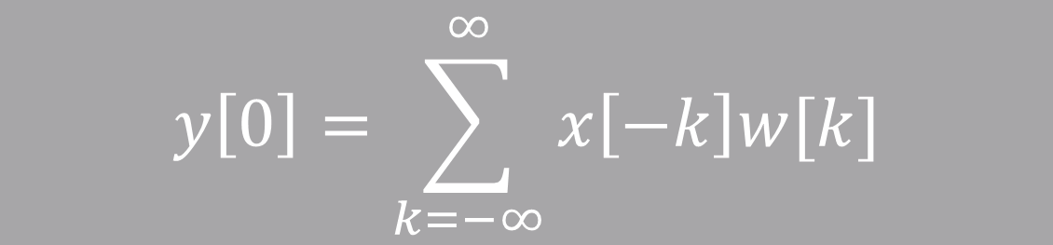

Infinite array
$$y=x∗w→y\left[i\right]=\sum_{k=−∞}^{∞}{x\left[i−k\right]w[k]}$$
$$y\left[0\right]=\sum_{k=−∞}^{∞}{x\left[−k\right]w[k]}$$
$$i=0$$
$$…+x\left[−1\right]w\left[1\right]+x\left[0\right]w\left[0\right] +x\left[1\right]w\left[−1\right]+…$$

Slide 5

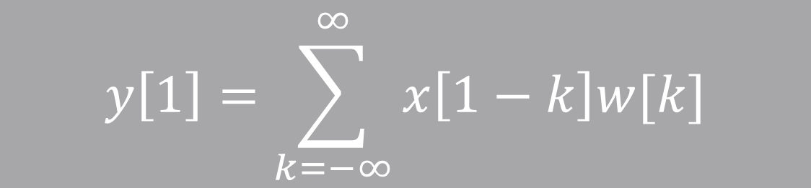
Infinite array
$$y=x∗w→y\left[i\right]=\sum_{k=−∞}^{∞}{x\left[i−k\right]w[k]}$$
$$y\left[0\right]=\sum_{k=−∞}^{∞}{x\left[−k\right]w[k]}$$
$$i=0$$
$$…+x\left[−1\right]w\left[1\right]+x\left[0\right]w\left[0\right] +x\left[1\right]w\left[−1\right]+…$$
$$y\left[1\right]=\sum_{k=−∞}^{∞}{x\left[1−k\right]w[k]}$$
$$…+x\left[0\right]w\left[1\right] +x\left[1\right]w\left[0\right]+x\left[2\right]w\left[−1\right]+…$$
$$i=1$$

Slide 6
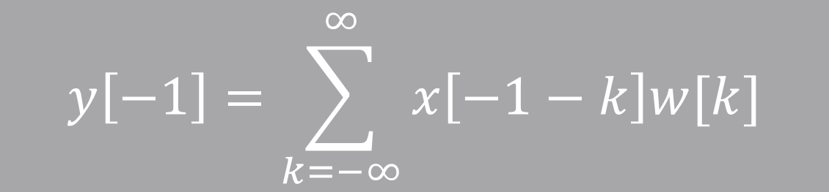

Infinite array
$$y=x∗w→y\left[i\right]=\sum_{k=−∞}^{∞}{x\left[i−k\right]w[k]}$$
$$y\left[−1\right]=\sum_{k=−∞}^{∞}{x\left[−1−k\right]w[k]}$$
$$i=−1$$
$$…+x\left[−2\right]w\left[1\right]+x\left[−1\right]w\left[0\right]+x\left[0\right]w\left[−1\right]+x\left[1\right]w[−2]$$
$$y\left[0\right]=\sum_{k=−∞}^{∞}{x\left[−k\right]w[k]}$$
$$i=0$$
$$…+x\left[−1\right]w\left[1\right]+x\left[0\right]w\left[0\right] +x\left[1\right]w\left[−1\right]+…$$
$$y\left[1\right]=\sum_{k=−∞}^{∞}{x\left[1−k\right]w[k]}$$
$$…+x\left[0\right]w\left[1\right] +x\left[1\right]w\left[0\right]+x\left[2\right]w\left[−1\right]+…$$
$$i=1$$

Slide 7
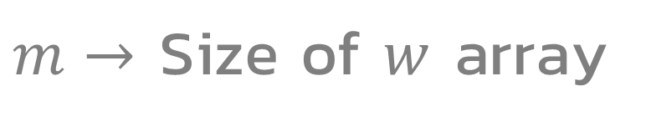
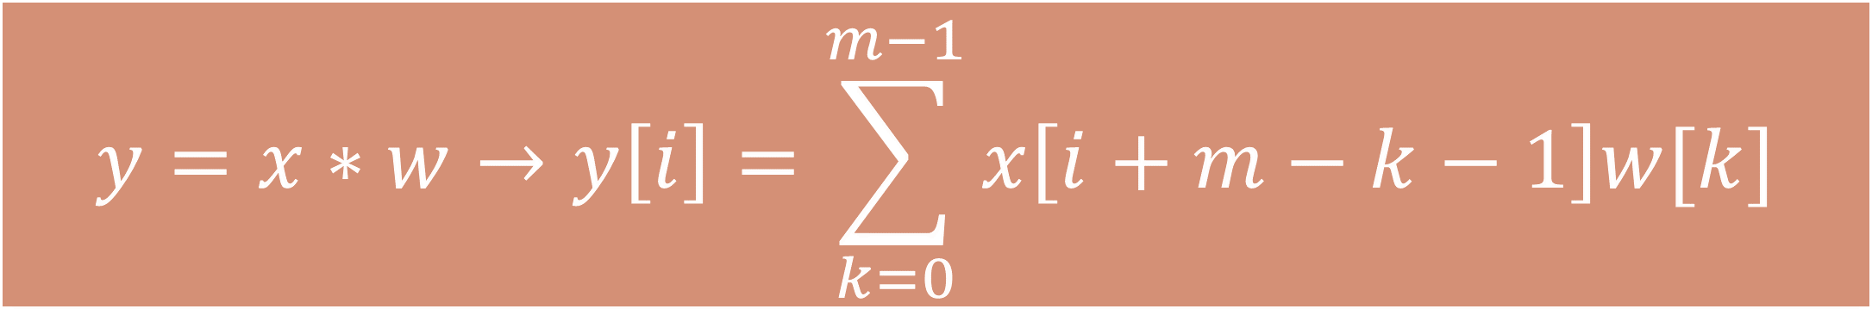
Finite array
$$y=x∗w→y\left[i\right]=\sum_{k=0}^{m−1}{x\left[i+m−k−1\right]w[k]}$$
$m→$ Size of $w$ array

Slide 8
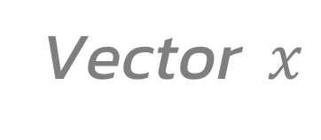
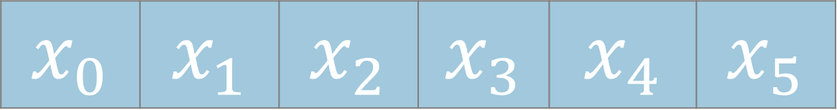


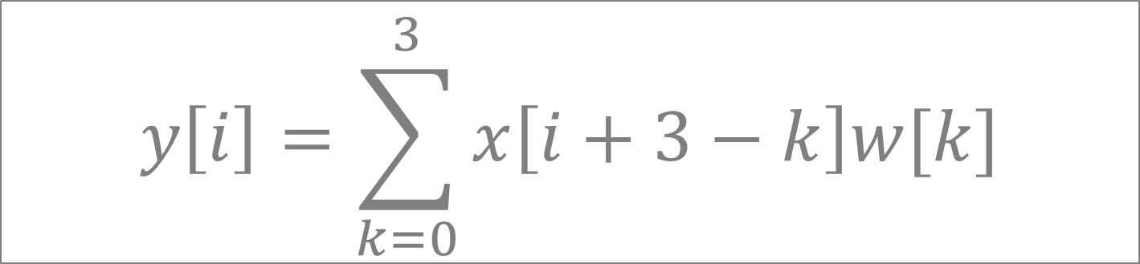
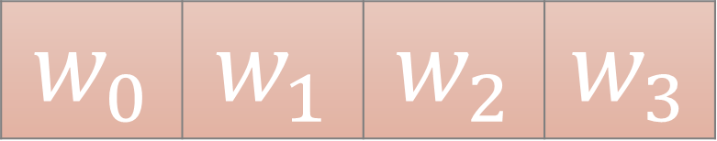

Finite array
$$y=x∗w→y\left[i\right]=\sum_{k=0}^{m−1}{x\left[i+m−k−1\right]w[k]}$$
$m→$ Size of $w$ array
Example
Vector $x$
Kernel $w$
$$x_{0}$$ | $$x_{1}$$ | $$x_{2}$$ | $$x_{3}$$ | $$x_{4}$$ | $$x_{5}$$
$$w_{0}$$ | $$w_{1}$$ | $$w_{2}$$ | $$w_{3}$$
$$n=6$$
$$m=4$$
$$y\left[i\right]=\sum_{k=0}^{3}{x\left[i+3−k\right]w[k]}$$

Slide 9

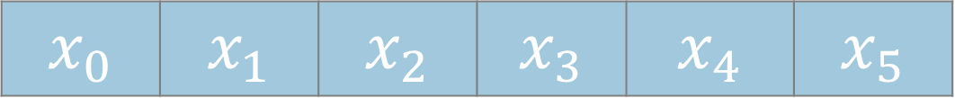
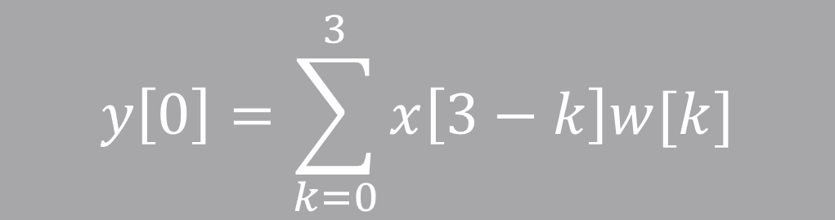

$$x_{0}$$ | $$x_{1}$$ | $$x_{2}$$ | $$x_{3}$$ | $$x_{4}$$ | $$x_{5}$$
$$y\left[0\right]=\sum_{k=0}^{3}{x\left[3−k\right]w[k]}$$
$$i=0$$
$$w_{0}$$ | $$w_{1}$$ | $$w_{2}$$ | $$w_{3}$$
$$y\left[0\right]=x\left[3\right]w\left[0\right]+x\left[2\right]w\left[1\right]+x\left[1\right]w\left[2\right]+x\left[0\right]w[3]$$

Slide 10



$$x_{0}$$ | $$x_{1}$$ | $$x_{2}$$ | $$x_{3}$$ | $$x_{4}$$ | $$x_{5}$$
$$y\left[0\right]=\sum_{k=0}^{3}{x\left[3−k\right]w[k]}$$
$$i=0$$
$$w_{0}$$ | $$w_{1}$$ | $$w_{2}$$ | $$w_{3}$$
$$y\left[0\right]=x\left[3\right]w\left[0\right]+x\left[2\right]w\left[1\right]+x\left[1\right]w\left[2\right]+x\left[0\right]w[3]$$
$$x_{0}$$ | $$x_{1}$$ | $$x_{2}$$ | $$x_{3}$$ | $$x_{4}$$ | $$x_{5}$$
$$y\left[1\right]=\sum_{k=0}^{3}{x\left[4−k\right]w[k]}$$
$$w_{0}$$ | $$w_{1}$$ | $$w_{2}$$ | $$w_{3}$$
$$i=1$$
$$y\left[0\right]=x\left[4\right]w\left[0\right]+x\left[3\right]w\left[1\right]+x\left[2\right]w\left[2\right]+x\left[1\right]w[3]$$

Slide 11

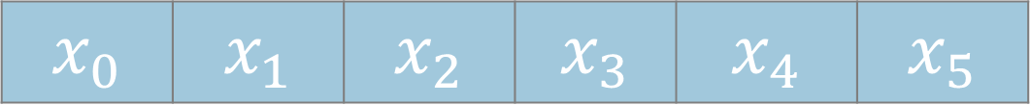


$$x_{0}$$ | $$x_{1}$$ | $$x_{2}$$ | $$x_{3}$$ | $$x_{4}$$ | $$x_{5}$$
$$y\left[0\right]=\sum_{k=0}^{3}{x\left[3−k\right]w[k]}$$
$$i=0$$
$$w_{0}$$ | $$w_{1}$$ | $$w_{2}$$ | $$w_{3}$$
$$y\left[0\right]=x\left[3\right]w\left[0\right]+x\left[2\right]w\left[1\right]+x\left[1\right]w\left[2\right]+x\left[0\right]w[3]$$
$$x_{0}$$ | $$x_{1}$$ | $$x_{2}$$ | $$x_{3}$$ | $$x_{4}$$ | $$x_{5}$$
$$y\left[1\right]=\sum_{k=0}^{3}{x\left[4−k\right]w[k]}$$
$$w_{0}$$ | $$w_{1}$$ | $$w_{2}$$ | $$w_{3}$$
$$i=1$$
$$y\left[1\right]=x\left[4\right]w\left[0\right]+x\left[3\right]w\left[1\right]+x\left[2\right]w\left[2\right]+x\left[1\right]w[3]$$
$$x_{0}$$ | $$x_{1}$$ | $$x_{2}$$ | $$x_{3}$$ | $$x_{4}$$ | $$x_{5}$$
$$y\left[2\right]=\sum_{k=0}^{3}{x\left[5−k\right]w[k]}$$
$$i=2$$
$$w_{0}$$ | $$w_{1}$$ | $$w_{2}$$ | $$w_{3}$$
$$y\left[2\right]=x\left[5\right]w\left[0\right]+x\left[4\right]w\left[1\right]+x\left[3\right]w\left[2\right]+x\left[2\right]w[3]$$

Slide 12
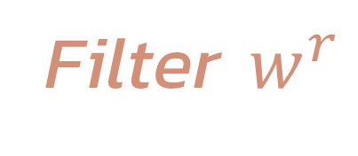


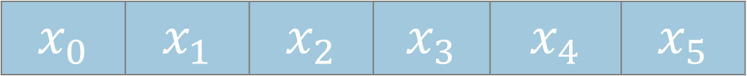

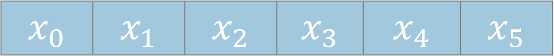
Reversing filter
$$y\left[0\right]=x\left[3\right]w\left[0\right]+x\left[2\right]w\left[1\right]+x\left[1\right]w\left[2\right]+x\left[0\right]x[3]$$
Filter $w$
Filter $w^{r}$
$$x_{0}$$ | $$x_{1}$$ | $$x_{2}$$ | $$x_{3}$$ | $$x_{4}$$ | $$x_{5}$$
$$x_{0}$$ | $$x_{1}$$ | $$x_{2}$$ | $$x_{3}$$ | $$x_{4}$$ | $$x_{5}$$
$$w_{0}$$ | $$w_{1}$$ | $$w_{2}$$ | $$w_{3}$$
$$w_{3}$$ | $$w_{2}$$ | $$w_{1}$$ | $$w_{0}$$

Slide 13




Padding
$$p=0$$
$$x$$
$$w$$
$$y$$

Slide 14



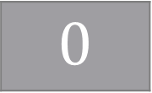


Padding
$$p=0$$
$$x$$
$$w$$
$$y$$
$$p=1$$
$$x$$
$$0$$
$$0$$
$$w$$
$$y$$

Slide 15








Padding
$$p=0$$
$$x$$
$$w$$
$$y$$
$$p=1$$
$$x$$
$$0$$
$$0$$
$$w$$
$$y$$
$$p=2$$
$$x$$
$$0$$
$$0$$
$$0$$
$$0$$
$$w$$
$$y$$

Slide 16
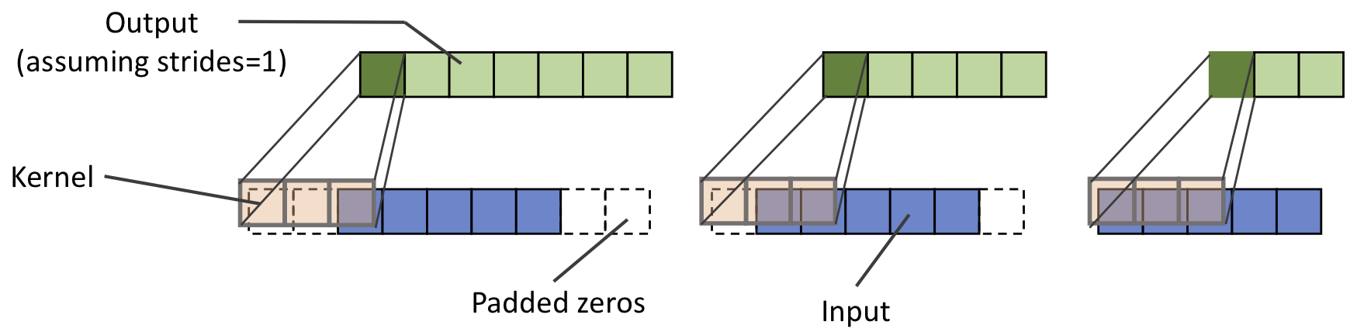
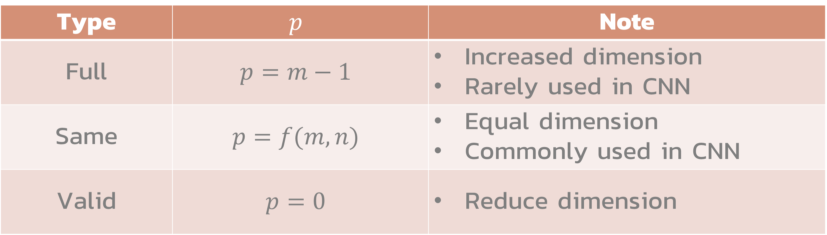
Padding types
Type | $$p$$ | Note
Full | $$p=m−1$$ | Increased dimension Rarely used in CNN
Same | $$p=f(m,n)$$ | Equal dimension Commonly used in CNN
Valid | $$p=0$$ | Reduce dimension
Full
Same
Valid

Slide 17




Stride
$$s=1$$
$$x$$
$$w$$
$$y$$

Slide 18




Stride
$$s=1$$
$$x$$
$$w$$
$$y$$
$$s=2$$
$$x$$
$$w$$
$$y$$

Slide 19

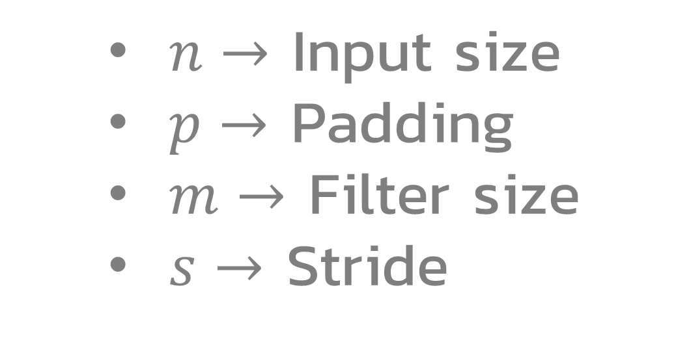
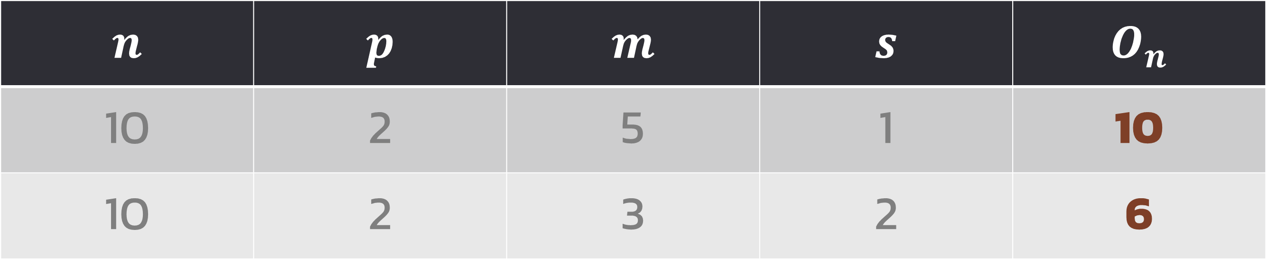
Output size
  $n→$ Input size
  $p→$ Padding
  $m→$ Filter size
  $s→$ Stride
$$O_{n}=floor\left[\frac{n+2p−m}{s}\right]+1$$
$$n$$ | $$p$$ | $$m$$ | $$s$$ | $$O_{n}$$
10 | 2 | 5 | 1 | 10
10 | 2 | 3 | 2 | 6
Same padding

Slide 20

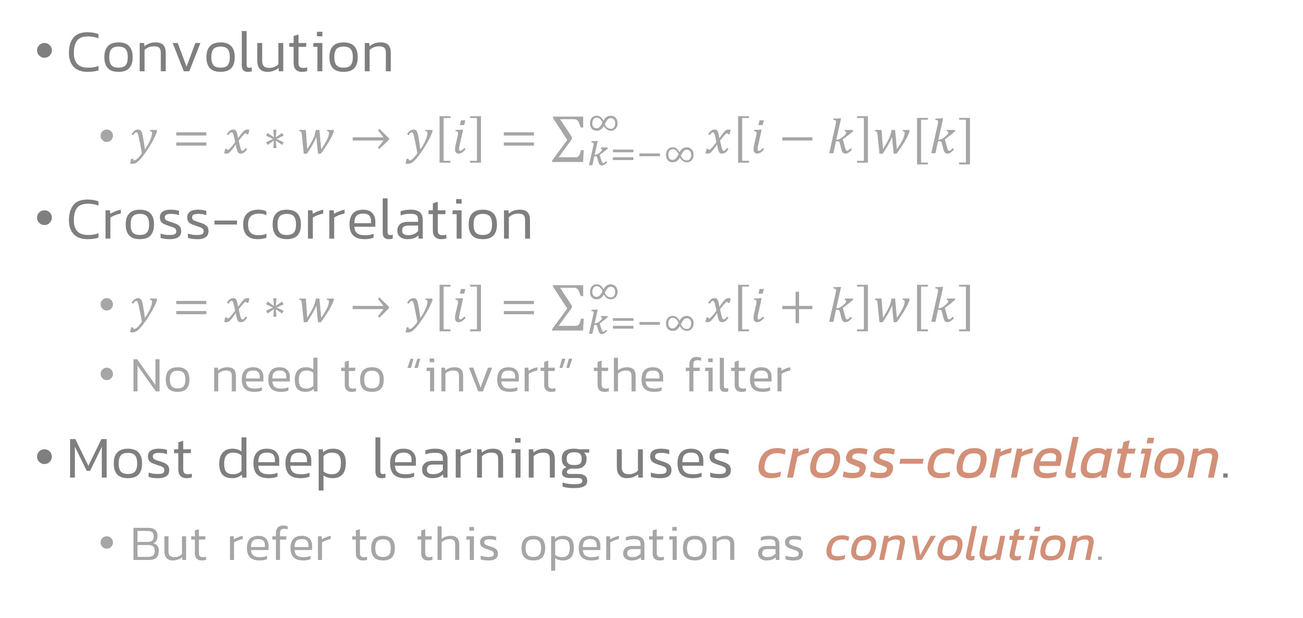
Cross-correlation
Convolution
  $y=x∗w→y\left[i\right]=\sum_{k=−∞}^{∞}{x\left[i−k\right]w[k]}$
Cross-correlation
  $y=x∗w→y\left[i\right]=\sum_{k=−∞}^{∞}{x\left[i+k\right]w\left[k\right]}$
  No need to “invert” the filter
Most deep learning uses cross-correlation.
  But refer to this operation as convolution.

Slide 21
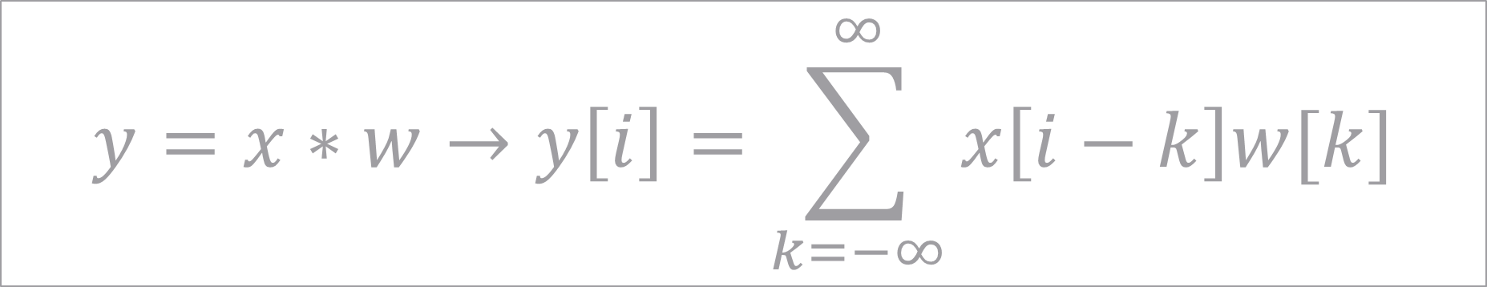
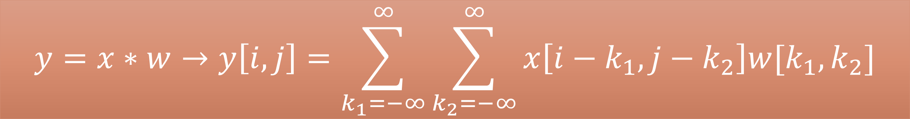
2D Convolution
$$y=x∗w→y\left[i\right]=\sum_{k=−∞}^{∞}{x\left[i−k\right]w[k]}$$
1D
$$y=x∗w→y\left[i,j\right]=\sum_{k_{1}=−∞}^{∞}{\sum_{k_{2}=−∞}^{∞}{x\left[i−k_{1},j−k_{2}\right]w[k_{1},k_{2}]}}$$
2D

Slide 22
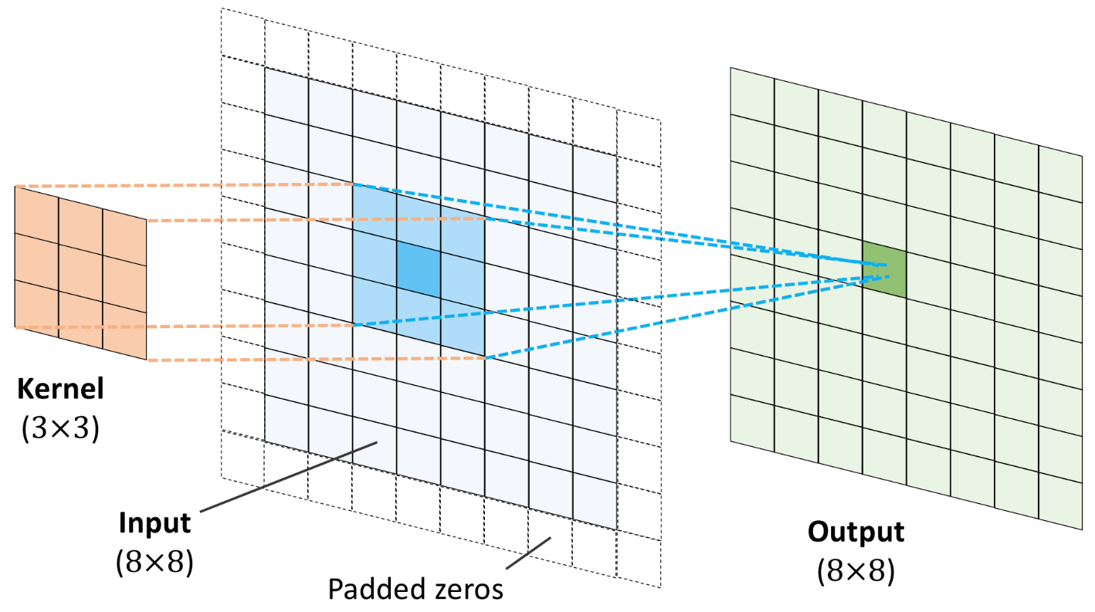
2D Convolution

Slide 23
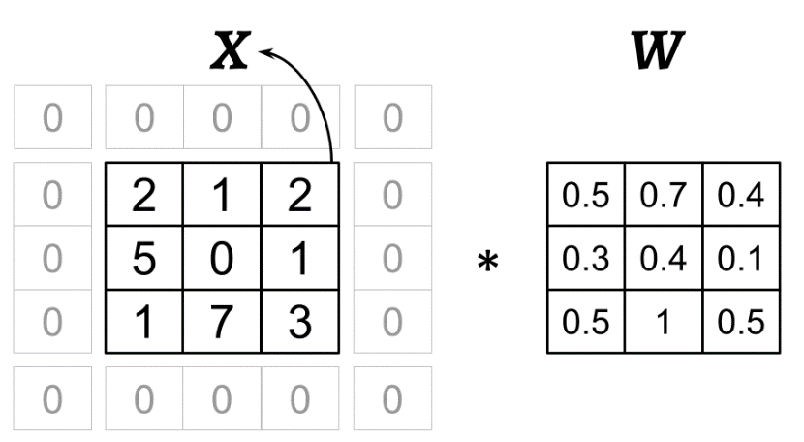
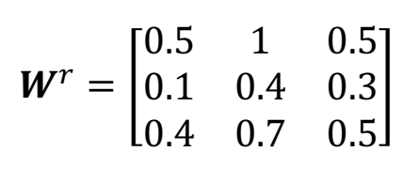
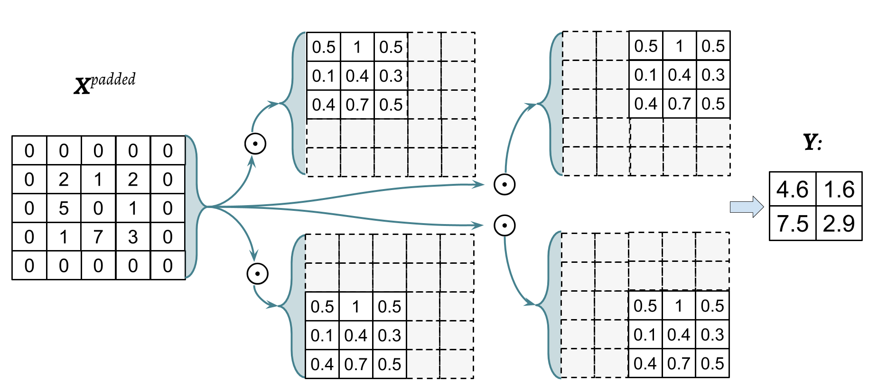
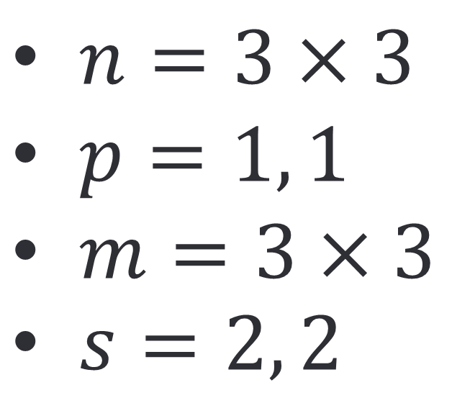
$n=3×3$
$p=1, 1$
$m=3×3$
$s=2, 2$

Slide 24
CNN

Slide 25
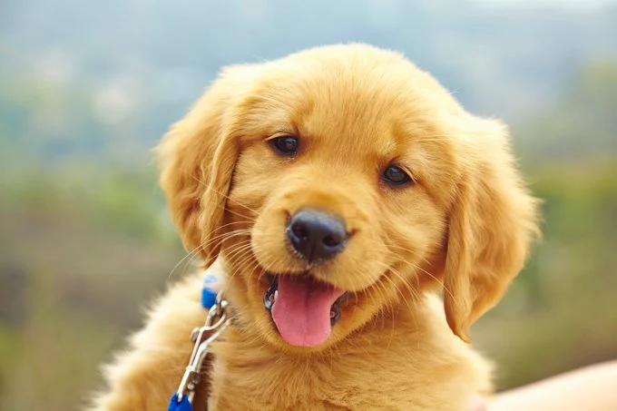
Visual recognition
Human can recognize a puppy in the picture effortlessly.
How can a computer recognize visual objects?

Slide 26
Convolutional neural network
CNN emerged from study of brain’s visual cortex. (เปลือกสมองส่วนการเห็น)
Neurons in visual cortex
  have local receptive field.
  react only to visual stimuli located in a limited region of the visual field.
  react to patterns that are combination of lower-level patterns.

Slide 27
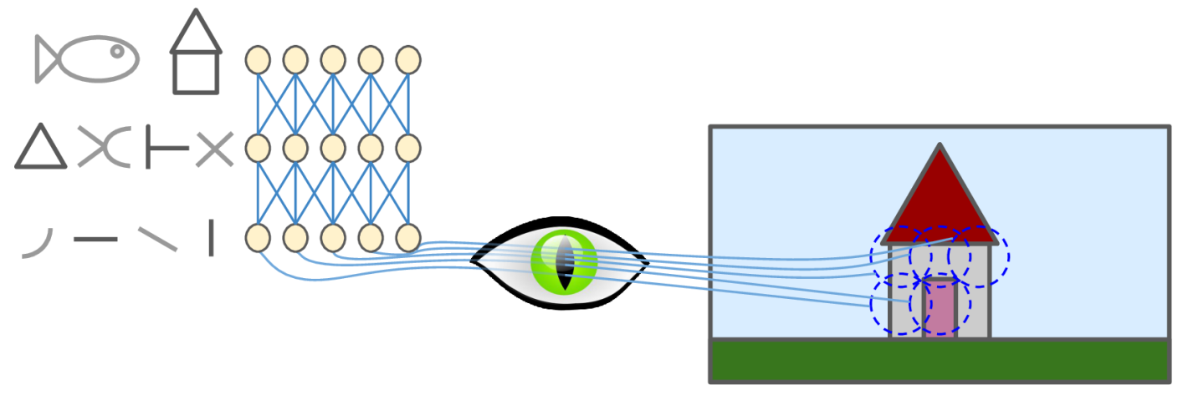

Slide 28
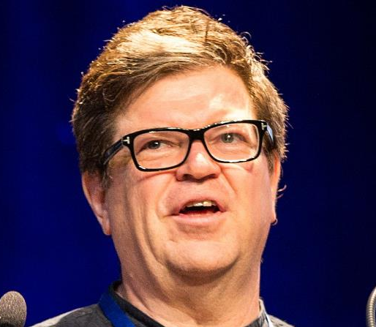
Convolutional neural network
Visual cortex studies leads to neocognition paper in 1980.
  Gradually leads to convolutional neural network.
LeCun et al. introduce the LeNet-5 architecture in 1998.
  Modern implementation of CNN.
  Employing back-propagation algorithm.
Yann LeCun in 2018

Slide 29
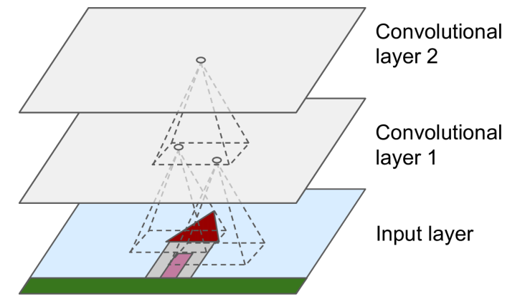
Convolutional layer

Slide 30
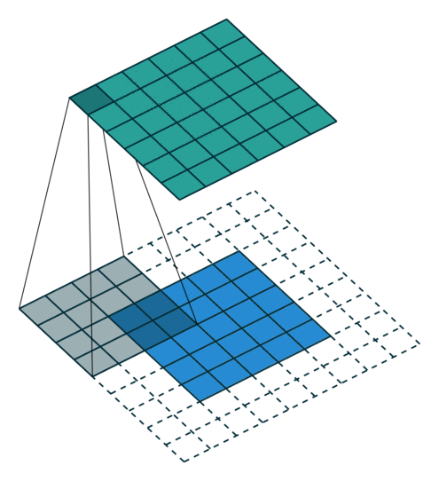
Kernels
2D array of weights
  Learned parameters
“Scan” through the layer.
  Convolution operation.
Produce an output
  Called a “feature map”.
Analogous to neuron’s receptive field
https://github.com/vdumoulin/conv_arithmetic

Slide 31
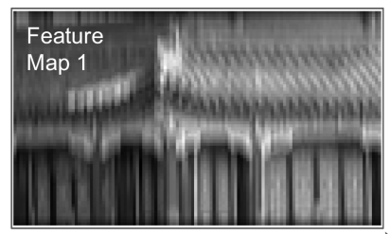
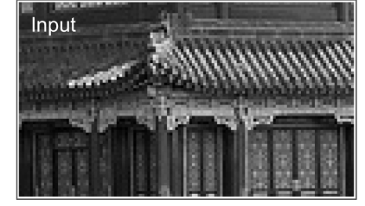
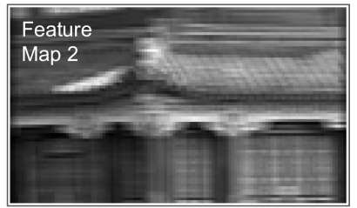
Vertical kernel
 |  |  | 1
 |  |  | 1
 |  |  | 1
 |  |  | 1
 |  |  | 1
 |  |  | 1
 |  |  | 1
Horizontal kernel
1 | 1 | 1 | 1 | 1 | 1 | 1
Blank cells contain zeros.

Slide 32
Advantage of CNN Layers
Compared with fully connected layer
Reduced parameters
  Kernel are “shared” with multiple neurons in the layers.
  Parameters does not increase with increased image size.
Consider a color image with 150x100 pixels
  A convolutional layer with 200 feature maps need ~15,000 parameters.
  Fully connected layers of the same size will need ~674 million parameters.

Slide 33
Advantage of CNN Layers
Compared with fully connected layer
Translation invariant.
  Due to scanning, location of features does not matter

Slide 34
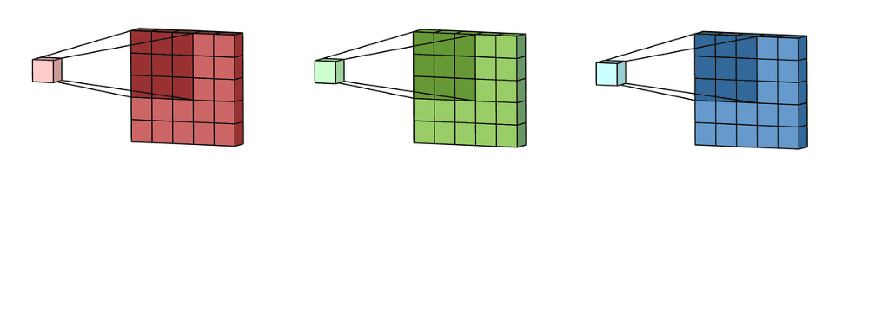
Channels
A color image has 3 channels.
  Neurons in the input layer become a 3D array.
  Width x Height x Channel
Need 3 kernels
https://towardsdatascience.com/a-comprehensive-introduction-to-different-types-of-convolutions-in-deep-learning-669281e58215

Slide 35
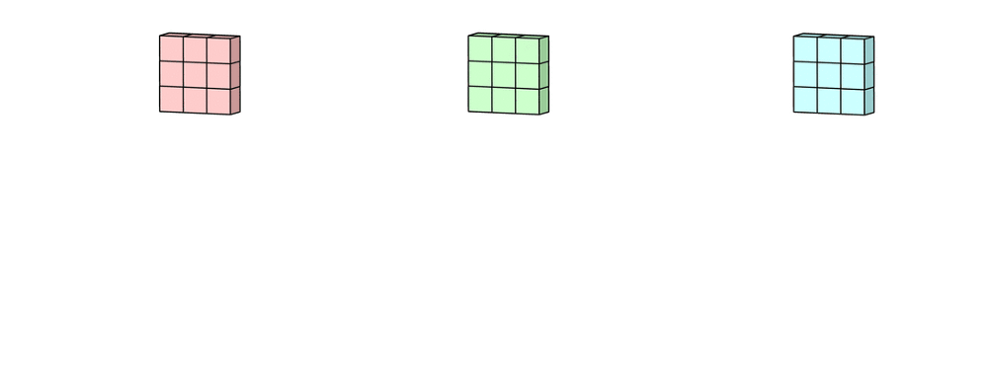
Channels
The result is summed to obtain a single feature map (yellow).
https://towardsdatascience.com/a-comprehensive-introduction-to-different-types-of-convolutions-in-deep-learning-669281e58215

Slide 36
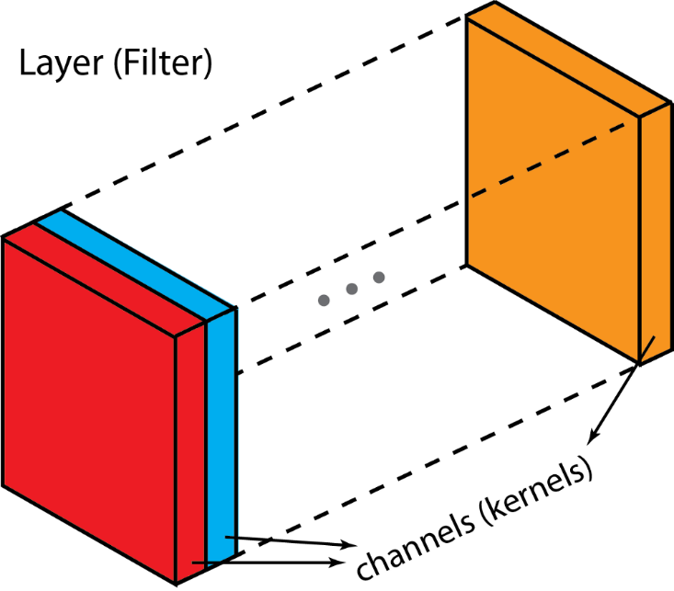
Filters
Multiple kernels stacks together.
Filters are 3D arrays.

Slide 37
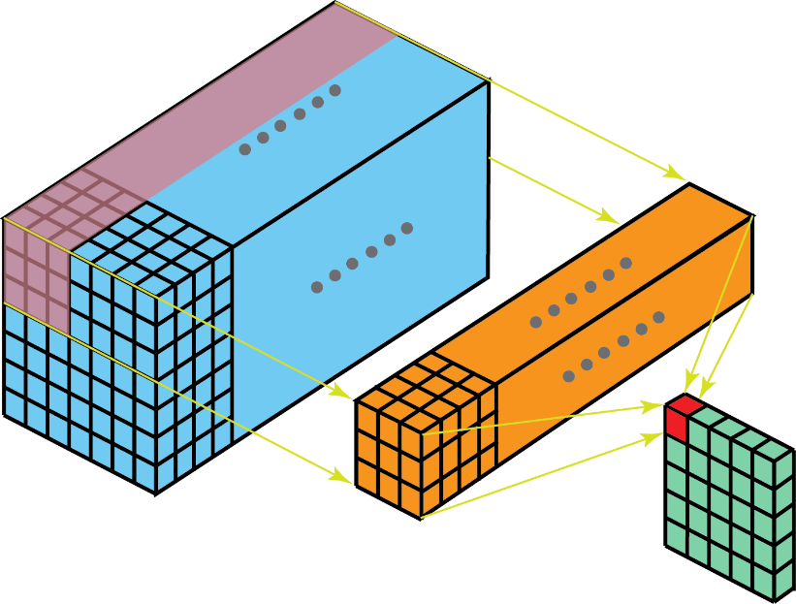
Filters
The input layer and the filter have the same depth
  Channel number = kernel number
The 3D filter moves only in 2-direction
  Height and width of the image
An output is a single channel.

Slide 38

Bias
Bias

Slide 39
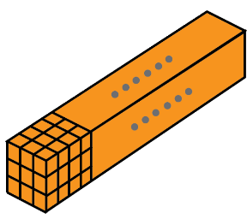
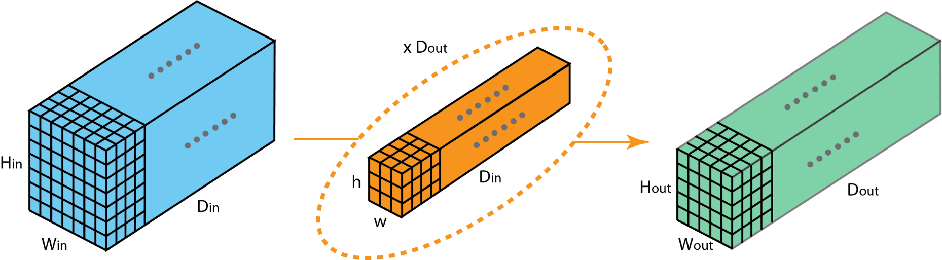

Multiple filters
$$D_{out}$$
Convolutional layer 1
Convolutional layer 2

Slide 40
Multiple biases
$$D_{out}$$
Convolutional layer 1
Convolutional layer 2

Slide 41


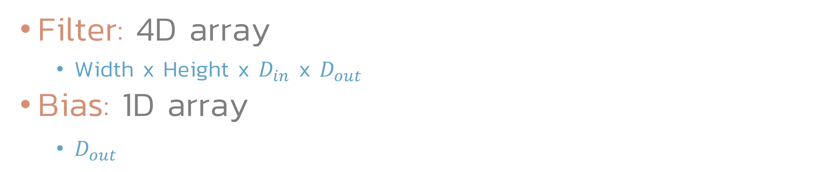
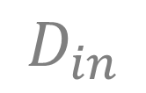


Dimensions
Filter: 4D array
  Width x Height x $D_{in}$ x $D_{out}$
Bias: 1D array
  $D_{out}$
$$H$$
$$D_{in}$$
$$W$$
$$D_{out}$$

Slide 42
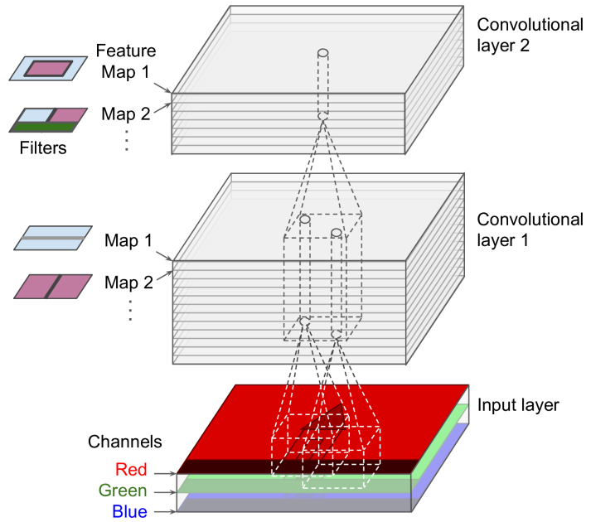

Slide 43
Exercise
Image
  Size: 32x32
  Number of channels: 3
Kernel
  Size: 5x5
  Number of filters: 32
  Padding: valid (0, 0)
  Stride: (1, 1)
How many parameters to train?
What is the output size?

Slide 44
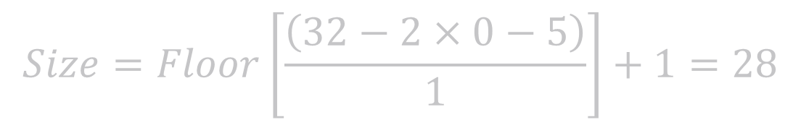

5x5
5x5
Kernel
Filter
Bias
3 Channels
3 Channels
32 Channels
32x32
28x28
5x5
5x5
5x5
5x5
32 Filters and Biases
$$Size=Floor\left[\frac{\left(32−2×0−5\right)}{1}\right]+1=28$$
  Number of parameters = $\left[3×\left(5×5\right)+1\right]×32=2432$
  Output size = $28×28×32$

Slide 45
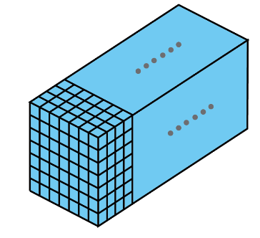



Multiple images
Neurons in each layer becomes 4D arrays.
  Batch x Width x Height x Channel
$$H$$
$$C$$
$$W$$
Batch

Slide 46
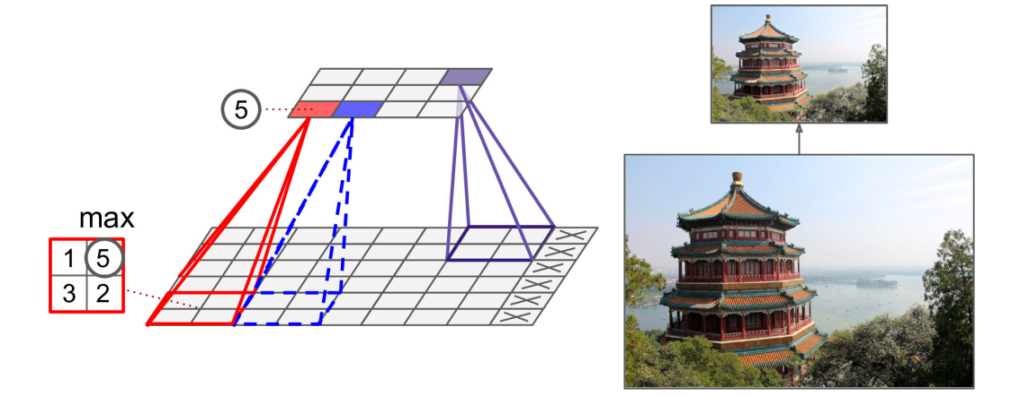
Pooling layer
Subsample neurons in the previous layer
  Using aggregate function such as max or mean.
Has no weight.
Characterize by size, stride, padding type.
Most common is max pooling layer.

Slide 47
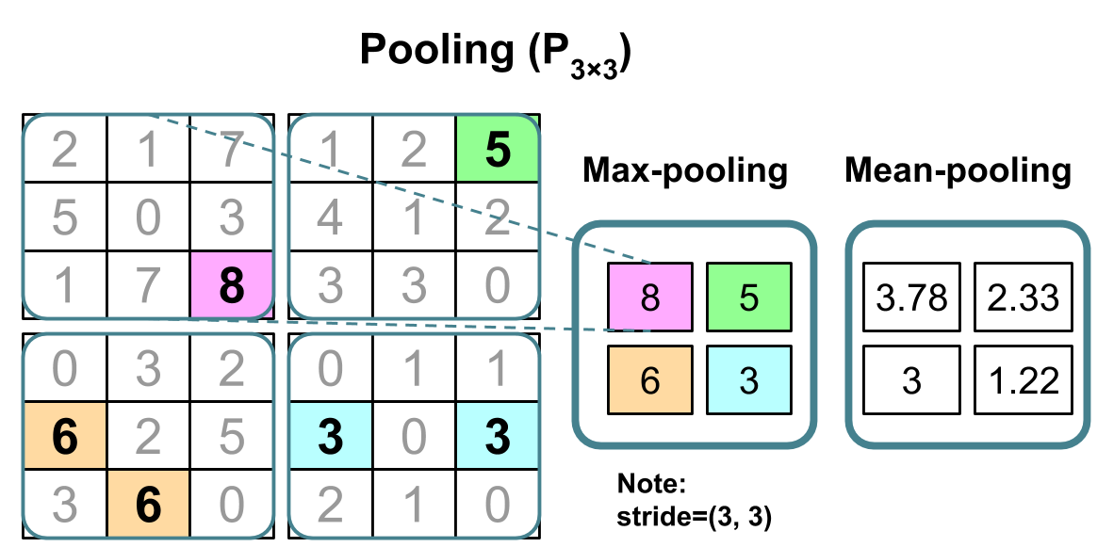
Pooling layer

Slide 48

Advantages of pooling layers
Decrease computational expense
  Reduce feature sizes.
Local invariance
  Small change in local neighborhood does not change the result of the max pool.
Assuming pool size = (2, 2) and no overlap
Small change in X does not affect the output

Slide 49


Dropout layer
Fraction of hidden units are randomly dropped with playability $p_{drop}$
  Weight of the neurons are rescaled to account for missing neurons.
Network is forced to learn redundant representation of the data.
  Network cannot rely on activation of any set of hidden units.
During evaluate, no dropout is used.

Slide 50

Loss function

Slide 51

Basic structure

Slide 52
Visualization
https://poloclub.github.io/cnn-explainer

Slide 53
CNN Architectures

Slide 54
LeNet-5
Most widely known CNN architecture.
Create by Yann LeCun in 1998.
Used for hand written digit recnognition.
  MNIST.

Slide 55



Slide 56
ILSVRC competition
ImageNet Large Scale Visual Recognition Challenge
  2010-2017 (8 years)
Task
  Evaluates algorithms for object detection and image classification at large scale.
Data
  15 million images
  22000 categories
https://www.image-net.org/challenges/LSVRC/

Slide 57


Slide 58

ILSVRC result
Top-5 Error
Exceed human ability

Slide 59
AlexNet (2012)
Won 2012 ILSVRC challenge.
Developed by Alex Krizhevsky, et al.
Much deeper than LeNet-5.

Slide 60



Slide 61

GoogLeNet
Won ILSVRC 2014 challenge.
Developed by Christian Szegedy et al. from Google Research.
Much deeper network
Use subnetwork called inception modules.
  Much more efficient.
Inception Modules

Slide 62



Slide 63

ResNet
Won ILSVRC 2015 Challenge.
Developed by Kaiming He et al.
152 layers
Use skip connection
  Residual learning
Residual learning

Slide 64


Slide 65


Slide 66


Slide 67
Current benchmark
https://paperswithcode.com/sota/image-classification-on-imagenet

